Slide 1
ICT and Law in Sri Lanka
Kalinga Dissanayake

Slide 2
Introduction

Slide 3

Introduction
Kalinga Dissanayake
Senior Software Architect at Cake Engineering
DIT/06/M1/1065
ICT And LAW

Slide 4
Agenda
Introduction to Sri Lankan Legal System
Three pillars
Sources of Law
ICT Related Acts
Intellectual Property Act, No 36 of 2003
Evidence (Special Provisions) Act, No 14 of 1995
Electronic Transactions Act, No 19 of 2006
Payment Devices Frauds Act, No. 30 of 2006
Computer Crimes Act, No 24 of 2007
Recap

Slide 5
Introduction to SL Legal Systems

Slide 6
Three pillars
Executive
Judiciary
Legislature
ICT And LAW
Notes:
the sovereignty (POWER) of the people in a democratic State shall be exercised through the Executive, the Legislature and the Judiciary and the manner in which the system of governance is structured and how it is implemented.

Slide 7
Three pillars
Executive
President
Cabinet of Ministers
Public Service
Legislature
Parliament
Provincial Councils
Judiciary
ICT And LAW
Notes:
The primary function of executive is to enforce laws and to maintain law and order in the state
The executive includes the president, cabinet of ministers and the public service
The president is the head of state, head of government and commander in chief of the armed forms
The president is responsibe to parliament for the excerise of duties under the constitution of SL
The president appointments the Cabinet responsible to parliament
President deputy is the prime minister
The parliments has 225 members of parliament that includes the folks coming from the national seat
The president may summon, suspend, or end a legislative session and dissolve Parliament any time after four and a half years

Slide 8
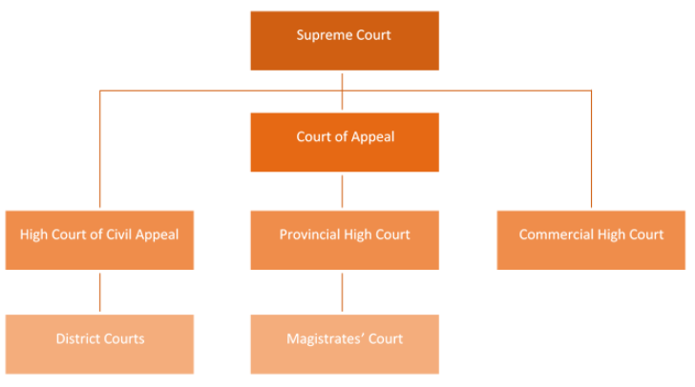
The Judiciary
Civil cases are handled by District courts cover almost all other disputes, and typically aim for some sort of recovery or compensation
Criminal offences are handled by Magistrate courts and High Courts (Laid out on CPC)
Notes:
http://www.jsc.gov.lk/web/index.php?option=com_content&view=article&id=51&Itemid=64&lang=en#The%20High%20Court

Slide 9
Other Administrative Tribunals and Special Courts
Rent Board
Ceiling on Housing Property Board
Land Acquisition Board
Quazis and Boards of Quazis
Labour Tribunals
The decisions of these bodies are capable of revision by the Appellate Courts by way of writs or appeals, as provided by the various enactments by which they had been established.

Slide 10
Sources of Law
Statutes
Case Law
Roman Dutch Law
English Law
Customs
ICT And LAW
Notes:
How a bill become a statue
- it has be gazettered first
- then after 7 days there is a first reading
- the after 7 days tehre is a second reading
- then there is a debate’
- then vote is taken (simple majority / absolute majority)
the earlier case law may still serve as “guidance,” and the word “guidance” suggests that the earlier case law is much closer to binding evidence than to persuasive evidence.
Today the personal laws in effect in Sri Lanka includes a combination of
English common law,
Roman-Dutch civil law and
customary laws such as Kandyan’ Law, ‘Thesawalamai’ Law and Muslim personal Law
Roman-Dutch Law now generally applies in Sri Lanka when statutes and indigenous laws do not regulate the issue in question. Roman-Dutch Law represents in Sri Lanka an inherited legal tradition. It has co-existed with several systems of indigenous laws, and the English common law, creating a “distinct legal culture that is described today as a ‘mixed’ civil and common law system.”
In fact, when the British themselves declared Roman-Dutch law as the common law of Ceylon, Roman-Dutch law assumed even greater importance under the British than it had enjoyed under Dutch rule of Ceylon.
Today, Roman-Dutch law exists only in Sri Lanka and South Africa.
Sri Lankan law is based on English common law system. As a result, the English law principles such as judicial precedent (lower courts follow the reasoning of the higher courts in similar, subsequent cases) and ratio decidendi (reasons for judgment) govern the interpretation of the case law. Civil cases are heard by the District Courts, and the Criminal cases by Magistrates’ Courts and High Courts. From decisions of these trial courts, an appeal lies to the Court of Appeals and then to the Supreme Court.

Slide 11
Agenda
Introduction to Sri Lankan Legal System
Three pillars
Sources of Law
ICT Related Acts
Intellectual Property Act, No 36 of 2003
Evidence (Special Provisions) Act, No 14 of 1995
Electronic Transactions Act, No 19 of 2006
Payment Devices Frauds Act, No. 30 of 2006
Computer Crimes Act, No 24 of 2007
Recap

Slide 12
Intellectual Property Act, No 36 of 2003

Slide 13
Intellectual Property Act No 36 of 2003
Intangible property that is the result of creativity, such as patents, copyrights, trademarks, trade secrets etc..
Created by human intellect, can have a monetary value.
Can be owned, transferred, sold or licensed for any another person to use
Governed by IPA No 36 of 2003
ICT And LAW
Notes:
142 page act ☺ it deserves a semester on its own

Slide 14
Intellectual Property Act No 36 of 2003
Patent Rights
Copy Rights
Trademarks and Service Marks
ICT And LAW
Notes:
Parents
Copy rights
Trade marks – visible sign serving to distinguish the goods of one enterprise from another
Service maeks – Trade marks are attached generally to products and service marks to services

Slide 15
Intellectual Property Act No 36 of 2003
Computer Programs are protected under Intellectual works protected under the act
Under the economic rights: “owner of copyright of a work shall have the exclusive right to carry out or to authorize the following acts in relation to the work”
ICT And LAW

Slide 16
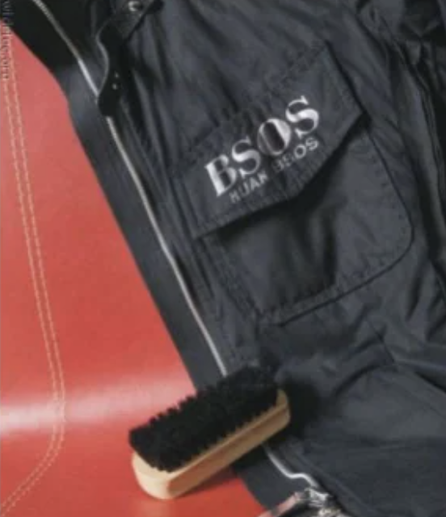
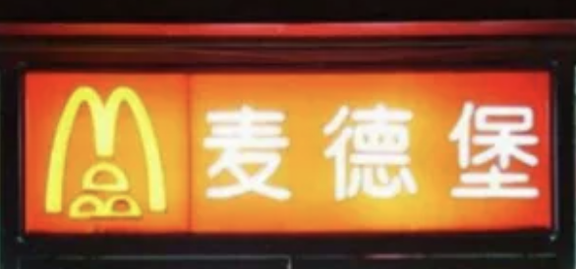
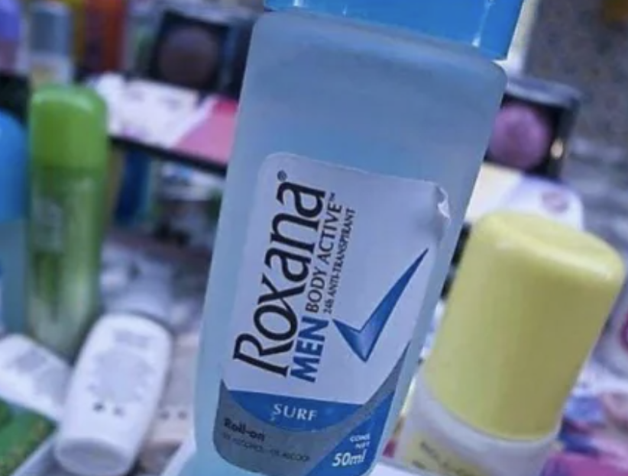
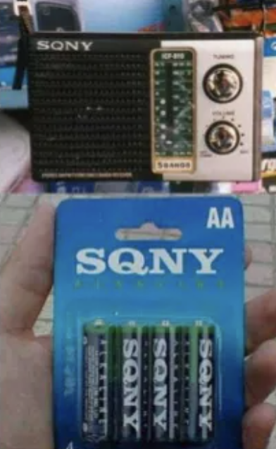
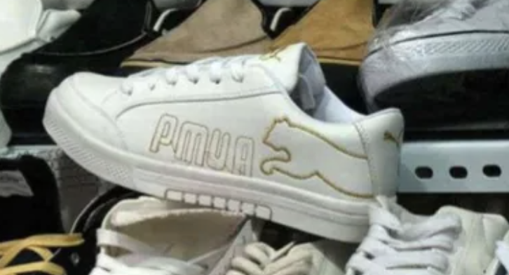
ICT And LAW

Slide 17
Intellectual Property Act No 36 of 2003
Any person has access to a computer program infringing the rights of another person, and willfully makes use of such program for commercial gain, shall be guilty of an offence and shall be liable on conviction by a Magistrate for a fine not exceeding rupees five hundred thousand or to imprisonment for a period of six months or to both such fine and imprisonment.
ICT And LAW

Slide 18
Evidence (Special Provisions) Act No. 14 of 1995

Slide 19
Evidence (Special Provisions) Act No. 14 of 1995
Provides for
(a)the admissibility of any contemporaneous recording made by electronic means and
(b)facts and information contained in a statement produced by a computer
Admissibility under this Act is subject to several conditions – that the computer producing the statement was operating properly, Information supplied to the Computer was accurate etc
ICT And LAW
Notes:
Comtemporaneous - existing at or occurring in the same period of time.

Slide 20
Electronic Transactions Act, No 19 of 2006

Slide 21
Electronic Transactions Act, No 19 of 2006
An Act to;
Recognize and facilitate the formation of;
Contracts
Creation and exchange of data messages
Electronic documents
Electronic Records
And other communications in electronic form in Sri Lanka
ICT And LAW

Slide 22
Electronic Transactions Act, No 19 of 2006
Section 3 - No data message, electronic document, electronic record or other communication shall be denied legal recognition, effect, validity or enforceability on the ground that it is in electronic form.
ICT And LAW

Slide 23
Electronic Transactions Act, No 19 of 2006
All transactions and business done in “electronic” form would be recognized under the Act, except those specifically excluded under Section 23 (Last Wills, Power of Attorney, Transfer of immovable Property etc)
ICT And LAW

Slide 24
Electronic Transactions Act, No 19 of 2006
Section 4 -Electronic equivalent of “Writing” - “Functional equivalence” principle
Section 5 & 6: Recognizes the fact information can be retained in electronic form
Section 8: Facilitates e-Government
Section 11 to 17: Electronic Contracts
ICT And LAW
Notes:
Section 11 - A contract shall not be denied legal validity or enforceability on the sole ground that it is in electronic form.

Slide 25
Electronic Transactions Act, No 19 of 2006
Section 7: Legal Validity of Electronic Signatures
Method used is proven in fact to have fulfilled the functions of identifying the party and proving the party’s intention in respect of the information contained in the message, by itself or together with further evidence
Any technology is acceptable - PIN No, QR Codes, Biometrics, Scanned signature etc.
Digital Certificates issued by “Certificate Service Provider” ensures Legal validity
ICT And LAW
Notes:
The minister in charge of information technology can form a certification authority that will regulate certificate service providers…

Slide 26
Agenda
Introduction to Sri Lankan Legal System
Three pillars
Sources of Law
ICT Related Acts
Intellectual Property Act, No 36 of 2003
Evidence (Special Provisions) Act, No 14 of 1995
Electronic Transactions Act, No 19 of 2006
Payment Devices Frauds Act, No. 30 of 2006
Computer Crimes Act, No 24 of 2007
Recap

Slide 27
Payment Devices Frauds Act, No. 30 of 2006

Slide 28
Payment Devices Frauds Act, No. 30 of 2006
An Act to;
Prevent the possession of unauthorized OR counterfeit payment devices;
Create offences connected with the possession or use of unauthorized payment devices.
Protect persons lawfully issuing and using such payment device
Make provision for the investigation, prosecution and punishment of such offenders
ICT And LAW

Slide 29
Payment Devices Frauds Act, No. 30 of 2006
Offences under this Act include;
Possessing equipment for the making or altering of payment devices (without proper approval or permission)
Using without lawful authority a phone listening device or other similar device, including any voice or data recording device, for the purpose of capturing authorization data passing through the acquirer’s point of sale networks or automated teller machine network
Possessing of any unauthorized or counterfeit payment device
Abetting any such offence
All such offences should be investigated under the Criminal Procedure Act
ICT And LAW

Slide 30
Payment Devices Frauds Act, No. 30 of 2006
A person guilty of an offence under this Act shall, on conviction after trial before the High Court:
In severe cases (as mentioned in item a. to j.) be liable to a term of imprisonment not exceeding ten years or to a fine not exceeding rupees five hundred thousand or to both such imprisonment and fine
In not so severe cases (item m. to p.) be liable to a term of imprisonment not exceeding three years or to a fine not exceeding one hundred thousand rupees or to a fine which may extend to five times the value of the money obtained by the commission of the act
ICT And LAW

Slide 31
Computer Crime Act No 24 of 2007

Slide 32
Computer Crime Act No 24 of 2007
Identification of Computer Crime
Provide procedures for investigation of such crimes
Provide procedures for prevention of such crimes
ICT And LAW

Slide 33
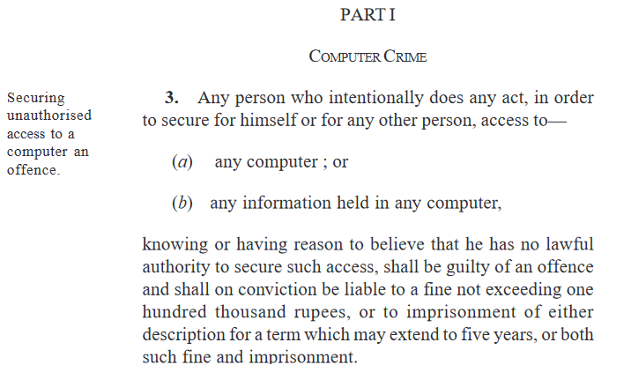
Computer Crime Act No 24 of 2007
ICT And LAW
Notes:
Securing
Unauthorized access to a computer
Unathorized access to any infroatmion held in any computer
** knowing that he/she has no such lawful authority
100K AND/OR 5 YEARS

Slide 34
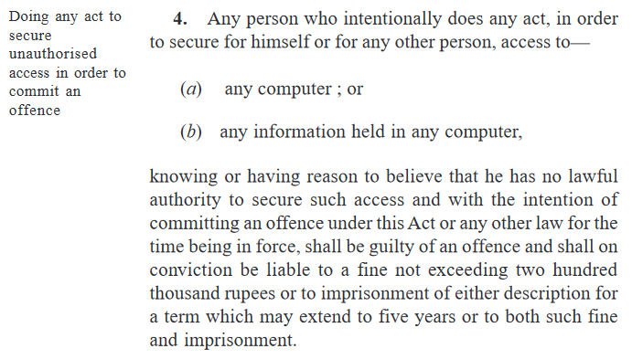
Computer Crime Act No 24 of 2007
ICT And LAW
Notes:
Securing
Unauthorized access to a computer
Unathorized access to any infroatmion held in any computer
WITH INTENTION OF COMMITTING AN OFFENCE
** knowing that he/she has no such lawful authority
200K AND/OR 5 YEARS

Slide 35
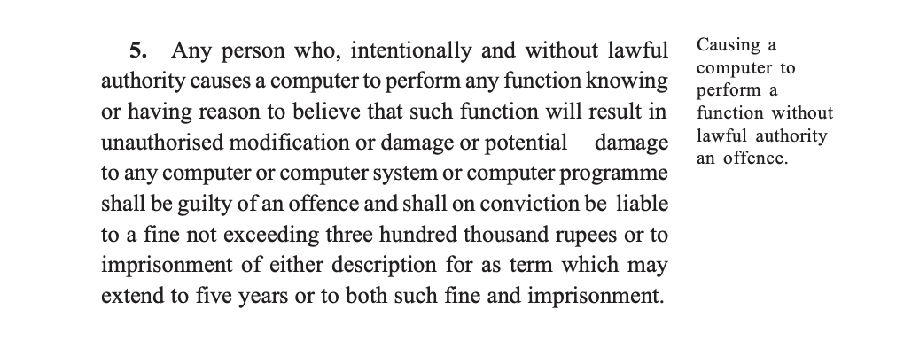
Computer Crime Act No 24 of 2007
ICT And LAW

Slide 36
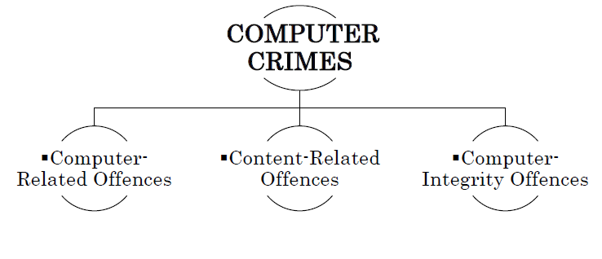

Slide 37
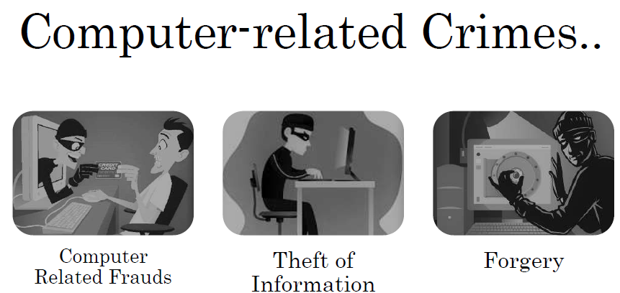
Notes:
Computer-related fraud includes many online swindles that involve false or misleading promises of love and companionship ( catphishing), property (through inheritance scams), and money and wealth (through lottery scams, investment fraud, inheritance scams, etc.).

Slide 38
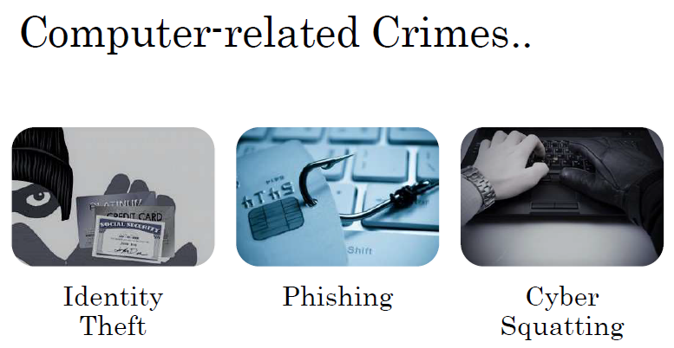
Notes:
Identity Theft
Phishing is a type of social engineering attack often used to steal user data, including login credentials and credit card numbers. It occurs when an attacker, masquerading as a trusted entity, dupes a victim into opening an email, instant message, or text message.
The term cybersquatting refers to the unauthorized registration and use of Internet domain names that are identical or similar to trademarks, service marks, company names, or personal names.
Registering dominoes.lk if it hadn’t been registered by the trademark owner.
Attempting to sell any top-level domain featuring “starbucks” after having no intent to legitimately use the website.
Registering potential misspellings or typos for starbucks.
Linking starbukcs.io to a website that sells competing coffee products.

Slide 39
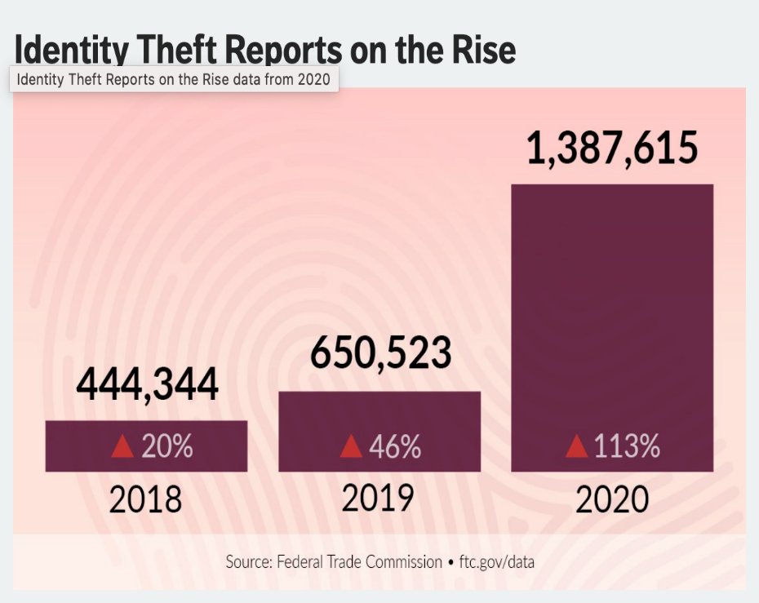
Examples
2014, Kim Kardashian was a victim of identity theft. 19-year-old Luis Flores, Jr. called the credit card company American Express claiming to be Kim Kardashian and changed her social security number and address to his own, so that he could receive new cards
ICT And LAW

Slide 40
Examples
2019, Florida- ordered the shutdown of seven websites that the owner was using to sell forgeries of Marc Jacobs, Celine and many other brands…
2021 - dettolhandsanitizer.com, tokyo2021.org
ICT And LAW

Slide 41
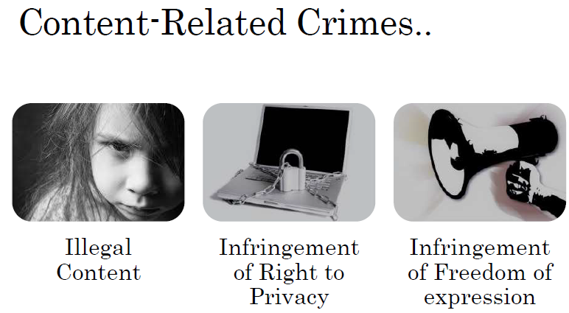
Notes:
Illegal Content
Child sexual abusive material
materials which encourage violence, criminal behaviour or dangerous behaviour (e.g. creating weapons, taking or making drugs and carrying out fraudulent or terrorist acts)
Infringement of Right to Privacy
An invasion of privacy can be defined legally as an unjustified disclosure of private and non-trivial information about an individual which causes distress to the individual
Infringement of Freedom of Expression
Governments have a duty to prohibit hateful, inciteful speech but many abuse their authority to silence peaceful dissent by passing laws criminalising freedom of expression. This is often done in the name of counter-terrorism, national security or religion. More recently, freedom of expression has come under threat by authorities clamping down on activists, NGOs and individuals helping refugees and migrants.

Slide 42
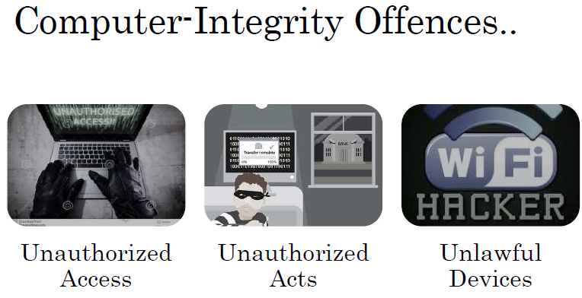
Notes:
NMRA incident – Unauthorized access

Slide 43


Examples
2021, Afghanistan - Chinese state-linked hackers targeted Afghan telecom provider Roshan and stole gigabytes of data from their corporate mail server over the past year.
2013, USA - Target confirmed that credit and debit card information about 40 million customers had been stolen
2020: Multiple DDoS attacks forced New Zealand's stock market to temporarily shut down
ICT And LAW

Slide 44
Computer Crimes Act
Section 17 – Appointment of a Panel of Experts
Minister of Science and Technology can appoint any public officer having the required qualification and experience in electronic engineering or software technology to assist any police officer….
The person appointed in considered as an “expert”..
ICT And LAW

Slide 45
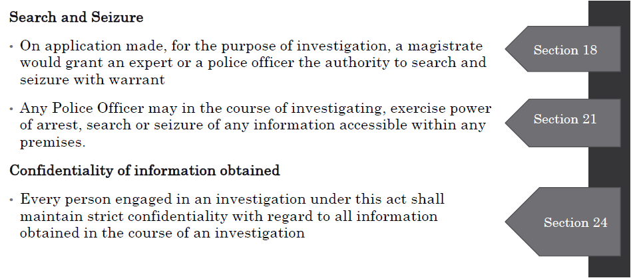
Computer Crimes Act
ICT And LAW

Slide 46


Slide 47
Summary
All these Laws have been enacted to have safe environment for computer use by general public to various activities in day today life without fear
These laws comprise of clauses to identify illegal activities and punish those who commit them
Law is continuously evolving
Professionals in ICT area must have a good understanding of these laws

Slide 48
la fin

Slide 49
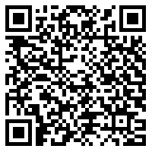
Questions?
https://docs.google.com/spreadsheets/d/1a4smdqcwOvltXnlVFWRsLqsdaD3CkR6OSkrxNEv-hfc/edit?usp=sharing

Slide 50
Constitution of Sri Lanka
https://www.parliament.lk/files/pdf/constitution.pdf
13th amendment to the constitution http://www.paffrel.com/posters/131202101231Sri%20Lankawe%20Palathsabha%20-%20English.pdf
Judiciary http://www.jsc.gov.lk/web/index.php?option=com_content&view=article&id=51&Itemid=64&lang=en#The%20High%20Court
Intellectual Property https://www.nipo.gov.lk/web/index.php?option=com_content&view=article&id=37&Itemid=156&lang=en
ETA Act
https://nca.gov.lk/files/ETA-E.pdf
Contact Details
Kalinga Dissanayake - https://www.linkedin.com/in/kalinga-dissanayake/
kalingakbd@gmail.com
ICT And LAW

Slide 51
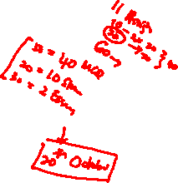
Assignment
Task 1: Find out four cases reported in media that come under the purview of these Acts of Law. Write short description (200 words max) about each.
Task 2: Reflect on impact of above Laws on your professional career. Write down your own rules for your professional life.
Submit PDF of your assignment on or before 16th October, 2021 mid night.

